Slide 1
Introduction of ER Model
Peter Chen developed the ER diagram in 1976.
The ER model was created to provide a simple and understandable model for representing the structure and logic of databases.
It has since evolved into the Enhanced ER Model and the Object Relationship Model.
The Entity Relational Model is a model for identifying entities to be represented in the database and representation of how those entities are related.
The Entity Relationship Diagram explains the relationship among the entities present in the database

Slide 2
Symbols Used in ER Model
Rectangles: Rectangles represent Entities in the ER Model.
Ellipses: Ellipses represent Attributes in the ER Model.
Diamond: Diamonds represent Relationships among Entities.
Lines: Lines represent attributes to entities and entity sets with other relationship types.
Double Ellipse: Double Ellipses represent Multi-Valued Attributes.
Double Rectangle: Double Rectangle represents a Weak Entity.

Slide 3
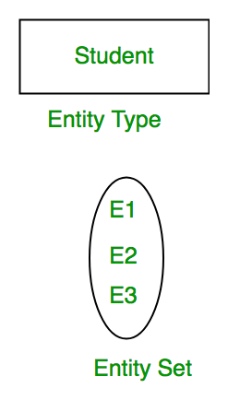
What is Entity?
An Entity may be an object with a physical existence – a particular person, car, house, or employee – or it may be an object with a conceptual existence – a company, a job, or a university course.
What is Entity Set?
An Entity is an object of Entity Type and a set of all entities is called an entity set. For Example, E1 is an entity having Entity Type Student and the set of all students is called Entity Set. In ER diagram, Entity Type is represented as:
We can represent the entity set in ER Diagram but can’t represent entity in ER Diagram because entity is row and column in the relation and ER Diagram is graphical representation of data.

Slide 4
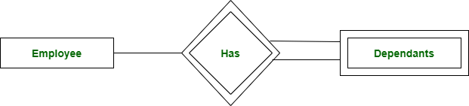
Types of Entity
There are two types of entity: 1. Strong Entity A Strong Entity is a type of entity that has a key Attribute. Strong Entity does not depend on other Entity in the Schema. It has a primary key, that helps in identifying it uniquely, and it is represented by a rectangle. These are called Strong Entity Types.

Slide 5
2. Weak Entity
An Entity type has a key attribute that uniquely identifies each entity in the entity set. But some entity type exists for which key attributes can’t be defined. These are called Weak Entity types .
For Example, A company may store the information of dependents (Parents, Children, Spouse) of an Employee. But the dependents can’t exist without the employee. So Dependent will be a Weak Entity Type and Employee will be Identifying Entity type for Dependent, which means it is Strong Entity Type .
A weak entity type is represented by a Double Rectangle. The participation of weak entity types is always total. The relationship between the weak entity type and its identifying strong entity type is called identifying relationship and it is represented by a double diamond.

Slide 6
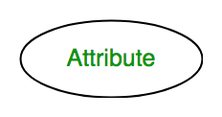
What is Attributes?
Attributes are the properties that define the entity type.
For example, Roll_No, Name, DOB, Age, Address, and Mobile_No are the attributes that define entity type Student.
In ER diagram, the attribute is represented by an oval.

Slide 7
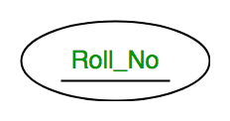
Types of Attributes
1. Key Attribute
The attribute which uniquely identifies each entity in the entity set is called the key attribute. For example, Roll_No will be unique for each student. In ER diagram, the key attribute is represented by an oval with underlying lines.

Slide 8
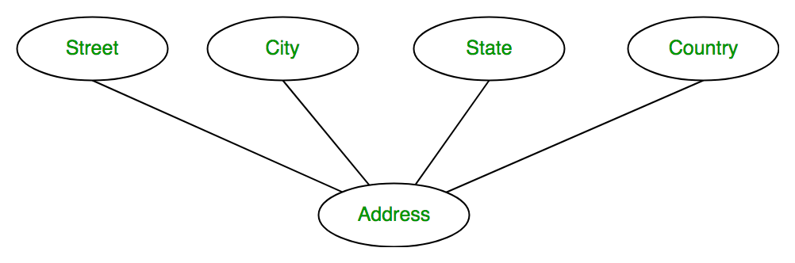
2. Composite Attribute
An attribute composed of many other attributes is called a composite attribute. For example, the Address attribute of the student Entity type consists of Street, City, State, and Country. In ER diagram, the composite attribute is represented by an oval comprising of ovals.

Slide 9
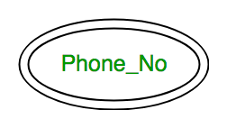
3. Multivalued Attribute
An attribute consisting of more than one value for a given entity. For example, Phone_No (can be more than one for a given student). In ER diagram, a multivalued attribute is represented by a double oval.
Address,Childress,Subjects,Books,Departments..can also be multivalued

Slide 10
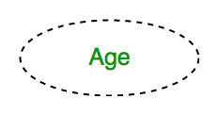
4. Derived Attribute
An attribute that can be derived from other attributes of the entity type is known as a derived attribute. e.g.; Age (can be derived from DOB). In ER diagram, the derived attribute is represented by a dashed oval.

Slide 11
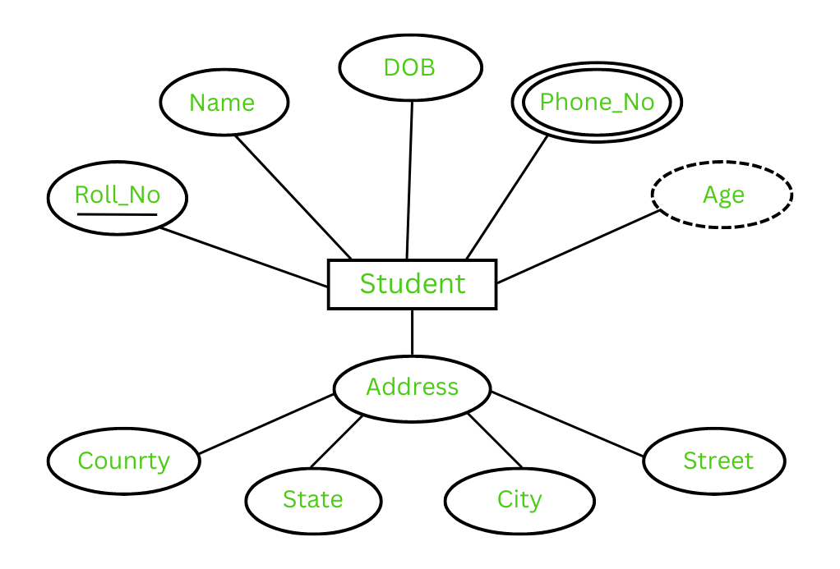
The Complete Entity Type Student with its Attributes can be represented as

Slide 12
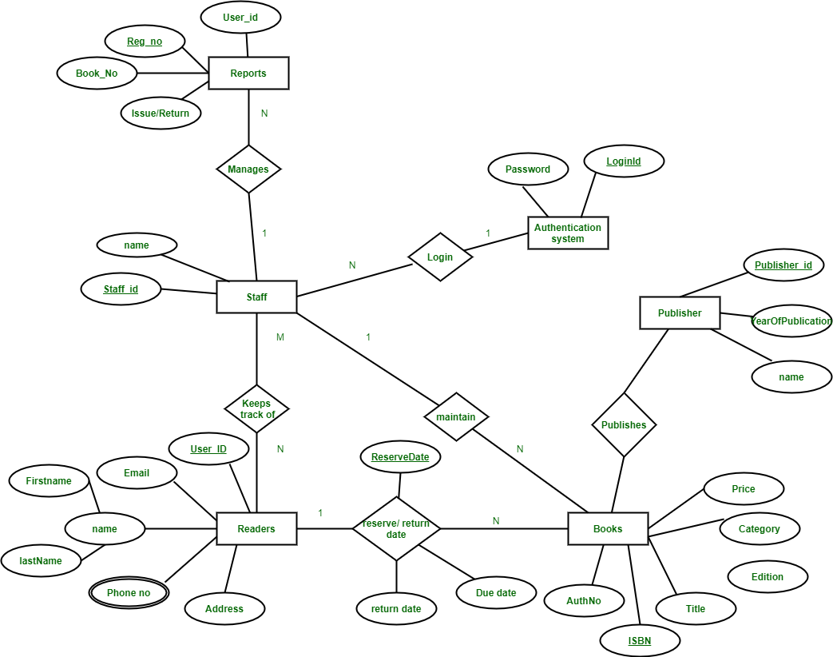

Slide 13
